Slide 1

Structural Pattern

Slide 2

Provide a surrogate or placeholder for another
object to control access to it

Slide 3

Surrogate

Slide 4

One reason for controlling access to an object is to defer the full cost of its creation and initialization until we actually need to use it.

Slide 5
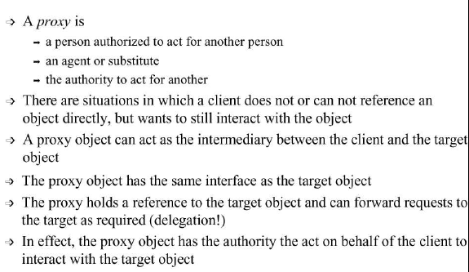

Slide 6

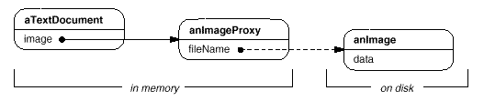

Slide 7

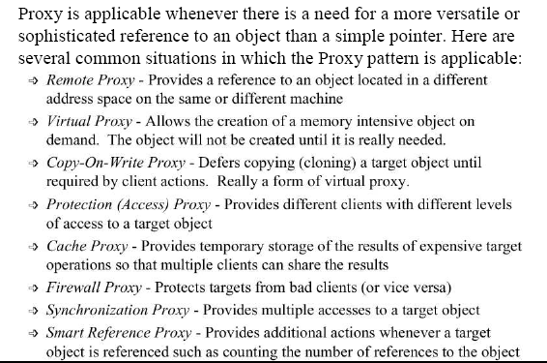

Slide 8

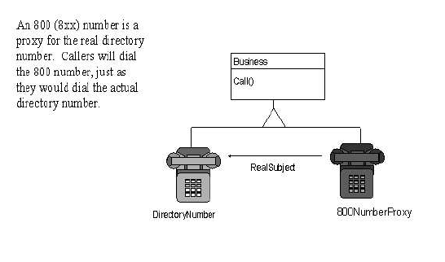

Slide 9

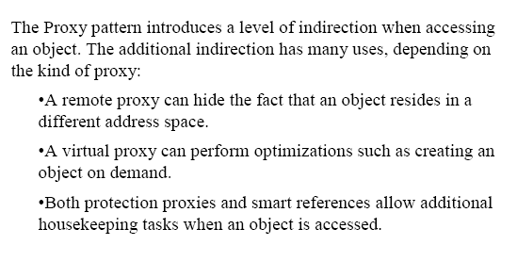

Slide 10

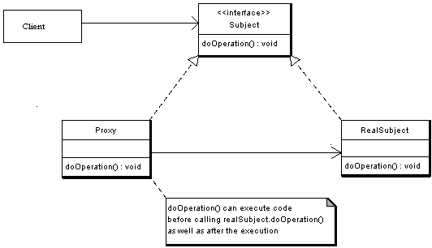

Slide 11

Subject - Interface implemented by the RealSubject and representing its services. The interface must be implemented by the proxy as well so that the proxy can be used in any location where the RealSubject can be used.
Proxy
  Maintains a reference that allows the Proxy to access the RealSubject.
  Implements the same interface implemented by the RealSubject so that the Proxy can be substituted for the RealSubject.
  Controls access to the RealSubject and may be responsible for its creation and deletion.
  Other responsibilities depend on the kind of proxy.
RealSubject - the real object that the proxy represents.

Slide 12

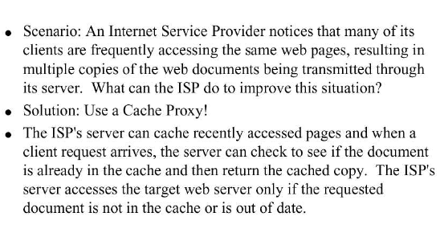

Slide 13

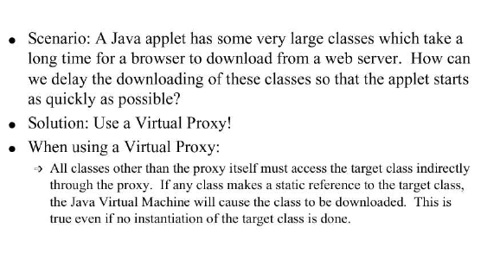

Slide 14

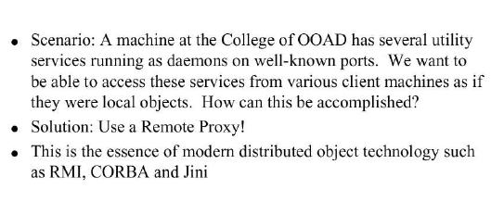

Slide 15

interface Image {
public abstract void displayImage();
}
//on System A
class RealImage implements Image {
private String filename;
public RealImage(String filename) {
this.filename = filename;
loadImageFromDisk();
}
private void loadImageFromDisk() {
System.out.println("Loading " + filename);
}
public void displayImage() {
System.out.println("Displaying " + filename);
}
}

Slide 16
//on System B
class ProxyImage implements Image {
private String filename;
private RealImage image;
public ProxyImage(String filename) {
this.filename = filename;
}
public void displayImage() {
if (image == null) {
image = new RealImage(filename);
}
image.displayImage();
}
}

Slide 17
class ProxyExample {
public static void main(String[] args) {
Image image1 = new ProxyImage("HiRes_10MB_Photo1"); Image image2 = new ProxyImage("HiRes_10MB_Photo2"); image1.displayImage(); // loading necessary image2.displayImage(); // loading necessary image1.displayImage(); // loading unnecessary
}
}

Slide 18
Output:
Loading HiRes_10MB_Photo1
Displaying HiRes_10MB_Photo1
Loading HiRes_10MB_Photo2
Displaying HiRes_10MB_Photo2
Displaying HiRes_10MB_Photo1

Slide 19

Adapter provides a different interface to its subject. Proxy provides the same interface. Decorator provides an enhanced interface.
Decorator and Proxy have different purposes but similar structures. Both describe how to provide a level of indirection to another object, and the implementations keep a reference to the object to which they forward requests.

Slide 20
Proxy used in Java API: java.rmi.*;
In java RMI an object on one machine (executing in one JVM) called a client can invoke methods on an object in another machine (another JVM) the second object is called a remote object. The proxy (also called a stub) resides on the client machine and the client invokes the proxy in as if it is invoking the object itself (remember that the proxy implements the same interface that RealSubject implements). The proxy itself will handle communication to the remote object, invoke the method on that remote object, and would return the result if any to the client. The proxy in this case is a Remote proxy.

